Slide 1
List

Slide 2
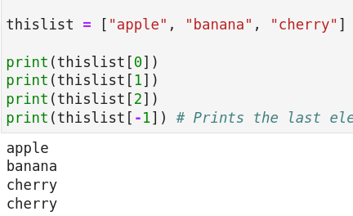
Indexing
# Accessing list items by using their index
# Note : index start from 0
# Note : Negative index start from -1
thislist = ["apple", "banana", "cherry"]
print(thislist[0])
print(thislist[1])
print(thislist[2])
print(thislist[-1]) # Prints the last element

Slide 3
Slicing (Part 1)
A slice has three parts: start index, end index and step.
Default value of start index: 0
Default value of end index: len()
Default value of step: 1
Q: What does this [2:5] expand to?
[2:5:1]
Q: What does this [:4] expand to?
Here, we can see that we have a single colon. This means that we have assume default value for step = 1.
Because the number before colon is missing that has to be start index. And number after colon is: end index.
[0:4:1]
Q: What does this [2:] expand to?
Answer: [2:len():1]

Slide 4

Slicing (Part 2)
# Accessing multiple items by using a range of indexes
thislist = ["apple", "banana", "cherry", "orange", "kiwi", "melon", "mango"]
print(thislist[2:5]) # Inclusive of 2 and exclusive of 5
print(thislist[:4]) # From Begining to specified index
# Note "kiwi" not included in the result
# This slice [:4] -> [0:4:1]
print(thislist[2:])
# This slice [2:] -> [2:7:1]
# 7 because it is the length of the list.
# Using Negative indexes
print(thislist[-4:-1]) # Note - last item index value is -1 and this not included in result

Slide 5
Adding elements to a list
Insert(): takes two arguments. First argument is the index.
Append(): takes one argument. That argument is an element to be appended in the list.
Extend(): takes one argument but that argument is a list for us.
Here: mainlist.extend(listtoappend)
It is equivalent to: mainlist = mainlist + listtoappend
Note: They lead to increase in the length of the original list.

Slide 6
Removing items from a list
Remove(): takes one argument. And argument is the element itself.
Pop(): takes one argument (defaults to ‘len()-1’ if no argument is passed) but that argument is the index.
Del: using the keyword ‘del’ delete from a specified index.
Clear(): empties a list

Slide 7
Problem
Q: Let the input list be: x = ["apple", "banana", "orange", "watermelon", "cherry"]
Show how you can reverse this list in three ways.

